Slide 1

Working With Data DATA9910
Week 7
Lucas Rizzo
email: lucas.rizzo@tudublin.ie

Slide 2
Schedule
Week 1 | Set up environment and R notebook
Week 2 | Review Python and practice
Week 3 | Importing data with R
Week 4 | Interpreting Data (summary statistics, data visualisation)
Week 5 | Data manipulation in R. Numpy and Pandas introduction in Python.
Week 6 | Review week (work on assignment)
Week 7 | Data visualisation in Python
Week 8 | Data processing (regular expressions)
Week 9 | Intro to databases (SQL) Assignment 1 deadline
Week 10 | Loading and extracting data (SQL)
Week 11 | Analytical SQL functions
Week 12 | Procedural SQL
Week 13 | Working on Assignment Assignment 2 deadline

Slide 3
Overview
Introduction to Python data viz package matplotlib
Plotting concepts
Overlaying plots
Aesthetics
Different chart types
Grid plots

Slide 4
Data Visualisation in Python
R is renowned for its data visualisation capabilities (ggplot2)
Python's main data viz package is matplotlib
The Seaborn package is another well knows Python data viz package. It is a wrapper around matplotlib that makes graphs look a little nicer

Slide 5
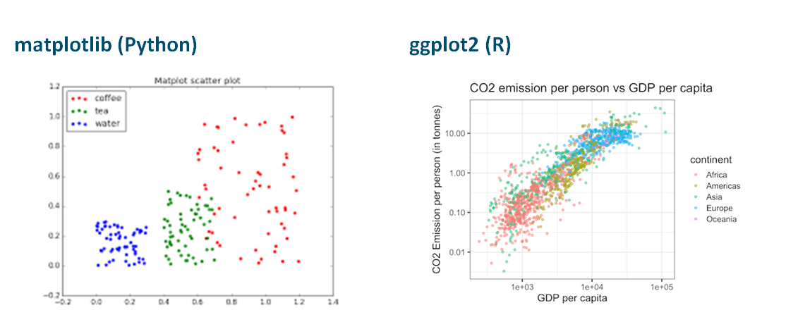
Data Visualisation: R vs Python

Slide 6
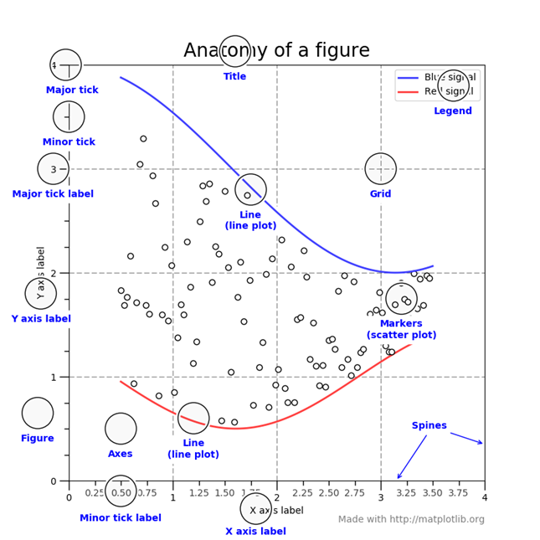
Matplotlib Components
Matplotlib's architecture is based on
Figures (Essentially a blank page)
Axes (a graph; not to be confused with axis)
Artists (The individual elements on a graph)

Slide 7
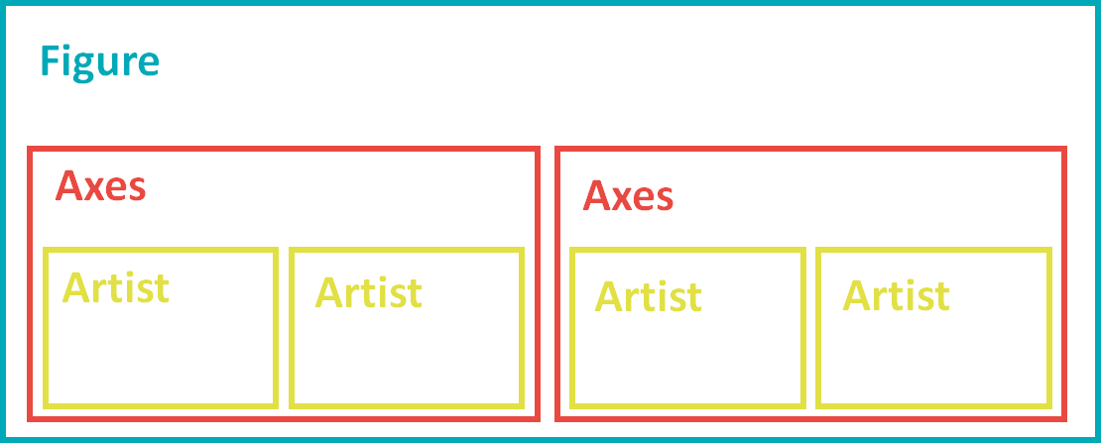
Plotting Concepts
Figure: the whole figure. The figure keeps track of all the child Axes, a smattering of 'special' artists (titles, figure legends, etc).
Axes: This is what you think of as 'a plot', it is the region of the image with the data space.
Artist: Basically, everything you can see on the figure is an artist (even the Figure, Axes, and Axis objects).
https://matplotlib.org/stable/tutorials/introductory/usage.html#sphx-glr-tutorials-introductory-usage-py

Slide 8
Examples of creating figures using pyplot
import matplotlib.pyplot as plt
import numpy as np
fig = plt.figure() # an empty figure with no Axes
fig, ax = plt.subplots() # a figure with a single Axes
fig, axs = plt.subplots(2, 2) # a figure with a 2x2 grid of Axes

Slide 9

Importing Matplotlib
Install matplotlib from the terminal
> pip install matplotlib
Import matplotlib.pyplot in your Python code
Import numpy in your Python code

Slide 10
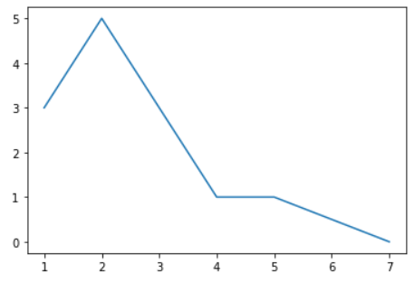
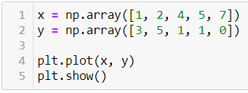
The plot() function
We can create a basic plot using the plot() function
The plot() function returns a line graph by default, but has lots of parameters which can be configured
Matplotlib also provides convenience functions such as scatter() which set some sensible defaults for different types of plots

Slide 11
Task 1: Using the format string
Have a look at the documentation for plot() (link here and in the Jupyter notebook)
Use the fmt (format) parameter to create a plot with magenta downward-facing triangles as markers all connected by a dashed line.
Answer in the next slide...

Slide 12
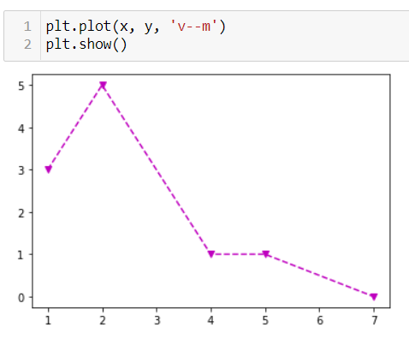
Task 1: Answer

Slide 13
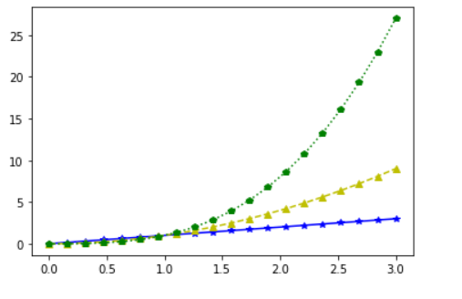
Overlaying Plots
Matplotlib lets us build our plot up one line of code at a time
Each call to plot() before plt.show() adds a visualisation to the current Axes
When we're done we can call plt.show() to show the current Axes and make sure all future calls to plot() are added to a new Axes.

Slide 14
Task 2: Overlaying Plots
Create 20 numbers evenly spaced between 0 and 3
Plot the function y=x using blue stars connected by a solid line (i.e. if x=1 then y=1; if x=2 then y=2 etc.)
Plot the function y=x**2 using yellow upward facing triangles connected by a dashed line
Plot the function y=x**3 using green pentagrams connected by a dotted line
Ensure all of the above series are plotted on the same Axes
Answer in the next slide...

Slide 15
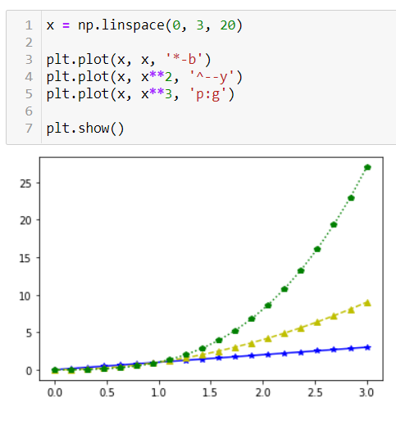
Task 2: Answer

Slide 16
Exploring Different Chart Types
In R we have geoms referring to the different plot types
Matplotlib doesn't really have an equivalent word (chart type?)
We looked at all the major chart types in Week 4
Use the jupyter notebook to explore how to create each of these chart types
Scatter
Histograms
Boxplots

Slide 17
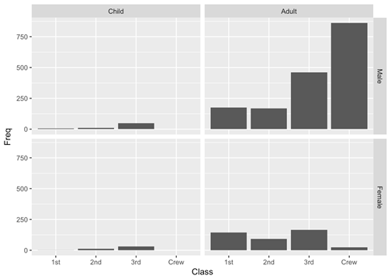
Subplots
In R we looked at faceting i.e. creating small multiples of plots
This was very useful for looking at how distributions changed according to a categorical variable
Matplotlib uses the subplot() function to achieve the same end

Slide 18
Using Subplot
Matplotlib supports grid-like subplots
plt.subplot(<num rows>, <num cols>, <index>)
The index refers to the index of the plot you want to work on next
Plot indices start at 1 in the top left and move left-to-right top-to-bottom
Sometimes people use the ridiculous syntax plt.subplot(231), meaning 2 rows, 3 columns with current index 1

Slide 19
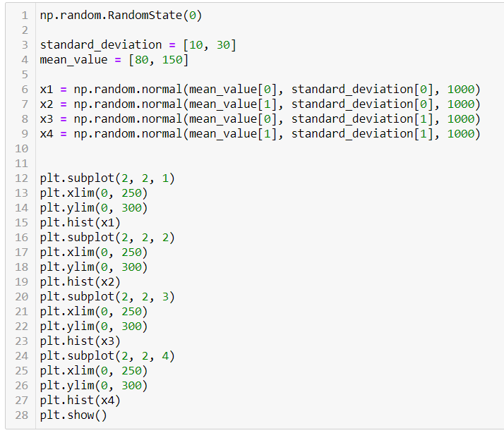
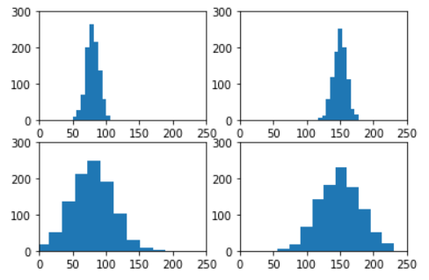
Using Subplot

Slide 20
Task 3: Using Subplot
The jupyter notebook gives you an array of 4 sets of x values and an array of 4 sets of y values
Plot each pair of x,y values in a 2 x 2 grid using matplotlib
Use the colors red, green, blue and yellow for each plot respectively
Advanced: Do this using a for loop
Tips in the next slide...

Slide 21
Task 3: Tips
Think which type of graph will give you the x,y points.
Check how to change the points’ colors.
Once you are able to plot one try to use subplot.
Once you manage to use subplot identify the parameters that need to be placed in a loop.
Answer in the next slide...

Slide 22
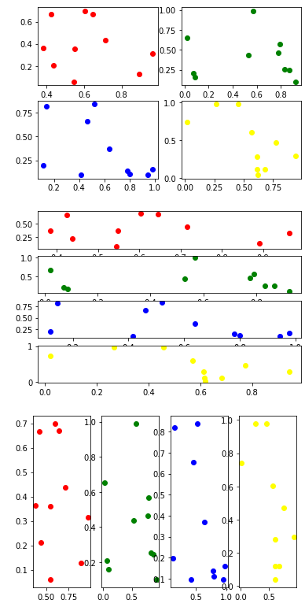
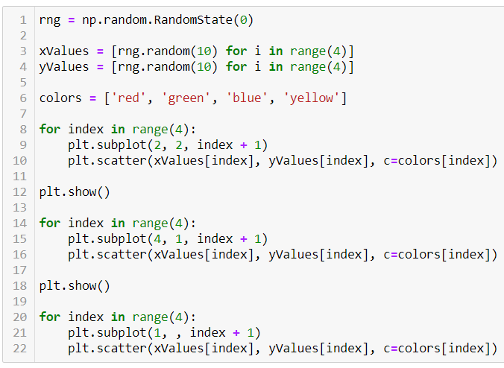
Task 3: Answer

Slide 23
Adding Elements to Plots
Good plots have lots of signposting, x axis, y axis, title etc.
Adding these elements is easy with matplotlib
Work through the Jupyter notebook to practice adding elements to your plots
Labels
Legends
Axis Calibration

Slide 24
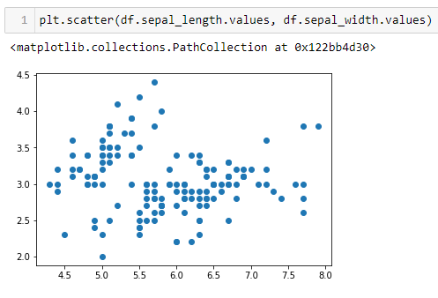
Pandas with Matplotlib
If we want to pass Pandas columns into matplotlib we first need to convert them to numpy arrays
The .values property of a Pandas column returns that column as a numpy array

Slide 25
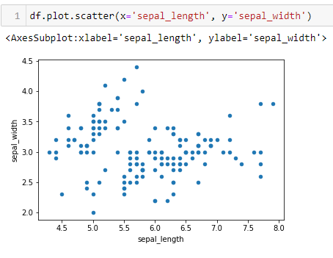
Tight Integration
An easier (but less powerful) way is to use the plotting functions built into pandas datasets
These functions are convenience functions which use the underlying matplotlib functions to do their job
Quicker and easier to write, but less easy to customize

Slide 26
Task 4: Colour By Column Value with Pandas
The c parameter to the pandas plot.scatter function lets us use a column to change the colour of markers
Unlike R, whatever column we choose must contain valid colour names
Use the data manipulation techniques we learned last week to create a colour column on the pandas dataframe
Use this column to ensure that the following colour scheme is used (based on the species column)
setosa is green
versicolor is red
virginica is blue
Tips in the next slide...

Slide 27
Task 4: Tips
Use the .loc for selecting data and creating a new colour column.
Answer in the next slide...

Slide 28
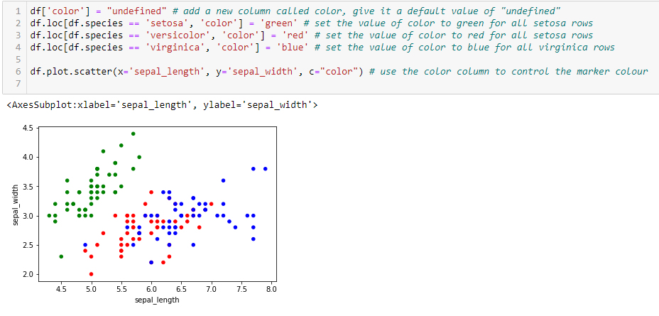
Task 4: Answer

Slide 29
Choosing a style
Matplotlib allows for easy customisation using styles.
You can see a style sheet reference in the documentation here.
Some quick guidelines:
Dark backgrounds are usually less visible
Colorblind-friendly styles: seaborn-colorblind and tableau-colorblind10
If you want to print your graphs you can use the grayscale style.
Try these styles in your notebook!

Slide 30
Saving to external files
We can easily save graphs to external files using the fig.savefig method.
We can manipulate the quality, dpi and size of the figures.
Try the examples in the notebook and check the files saved in the current working directory.

Slide 31
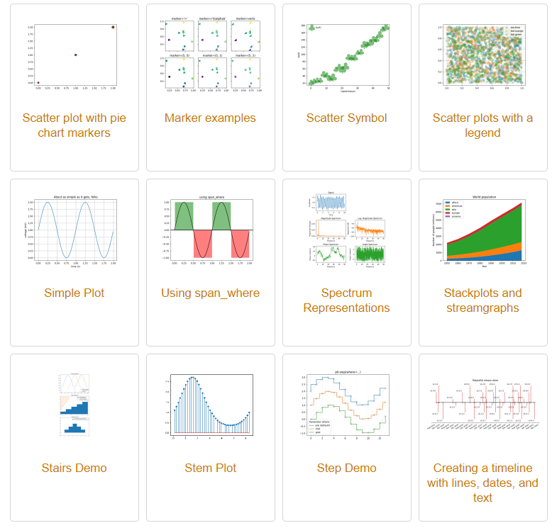
More examples!
If you want to check other visualisations with matplotlib check their gallery
It is never a problem to start from some of the examples =)
https://matplotlib.org/stable/gallery/index.html

Slide 32
Summary and further reading
Python has some powerful visualisation tools provided by the matplotlib package
Good for quick and dirty visualisations
Probably not as good as R in terms of ease-of-use or quality-of-output (though the Seaborn package slightly improves graph appearance)
Good to know both, which one you use is a matter of personal preference.
A Seaborn introduction can be found in datacamp
https://app.datacamp.com/learn/courses/introduction-to-data-visualization-with-seaborn
https://app.datacamp.com/learn/courses/intermediate-data-visualization-with-seaborn

Slide 33
Lab
No lab this week. Time to work on assignment.

Slide 34
Questions?

